Slide 1
I-phone Purchase Project
By Using K-nearest Neighbours (KNN)

Slide 2
Objective :
The main objective of this project is to predict whether a user will purchase an iPhone based on feature like age , gender , and salary . By doing so ,we can find potential customer likely to buy iPhone on basis our prediction which we done on iPhone purchase prediction data
we use K-Nearest Neighbours (KNN) classification model for prediction task .

Slide 3
Solution:
Data set overview :
Data : I phone purchase prediction .csv
In this project we use K-Nearest Neighbours (KNN) and dataset contain 4 Columns
Dependent columns : Purchase I phone (yes , No)
Independent columns : Gender , Age , Salary
K-Nearest neighbours (KNN) :
Data processing :
Collected and cleaned the I phone purchase prediction data by converting the ‘ Gender ‘Male (0) and Female (1.)
Spilt the data set into training and testing and trained the model using multiple value k (1 TO 20)

Slide 4
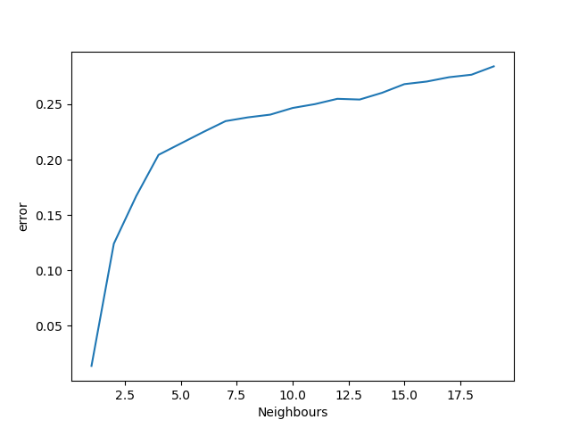
Graph summary :
In the graph x –axis is number of neighbors (1 to 20) and y-axis is error . In graph number of neighbors increases from 1 to 20 then the number of error also increases gradually.
The error was lowest when k was between 3 and 5, indicating better model performance .high values of k led to increased error due to underfitting,

Slide 5
Model evaluation :
Evaluated the model using R2core and MSE
Also evaluated minimum error in model
And created the viz to study error trend
Score of the KNN model for I phone purchase prediction is : 78 %

Slide 6
Business impact :
This model helps identify high-potential customers before the launching marketing campaigns .
Company can run targeted advertisement to specific segment fo the people who likely buy I phone in future
By using this data company can use insight for customer profiling , helping sales and product teams to better understanding of market behaviour

Slide 7
Thank you !

